Slide 1

Exchange Rates

Slide 2
The Terms of Trade
（TOT）

Slide 3
The Terms of Trade
Terms of Trade: 贸易条件 = P/P^{f}.
  P：本国商品的本国价格
  P^{f}：外国商品的本国价格
The units for the terms of trade are
  (￥ per home good)/(￥ per foreign good) = # of foreign good per home good
  The terms of trade give the number of units of foreign goods that can be imported for each unit of home goods exported.

Slide 4
The Terms of Trade
If the terms of trade, P/P^{f}, rises, or improves, the home country is better off because it gets more foreign goods in exchange for each unit of home goods.
If P/P^{f} falls, or worsens, the home country is worse off because it gets fewer foreign goods in exchange for each unit of home goods.

Slide 5
The Terms of Trade
In our equilibrium business-cycle model, economic fluctuations result from shocks to the technology level, A.
For a single country, changes in the terms of trade have effects that are similar to changes in A.

Slide 6
The Terms of Trade
The Terms of Trade and the Current-Account Balance
  current-account balance in nominal terms is
    B^{f}_{t} − B^{f}_{t−1} = PY_{t}+ r_{t−1}·B^{f}_{t−1} − P· ( C_{t}+ I_{t}+ G_{t})
    nominal current-account balance
    = nominal GNP − nominal domestic expenditure

Slide 7
The Terms of Trade
  假定一个最简单的场景：本国将其生产的全部商品都出口，从而任何本国实际GDP都不会直接用于本国的消费、国内投资和政府购买。相反，本国进口外国商品以满足本国的消费、国内投资和政府购买。
  The nominal current-account balance becomes: B^{f}_{t} −B^{f}_{t−1} = PY_{t}+r_{t−1}·B^{f}_{t−1}−P^{f}· (C_{t}+I_{t}+G_{t})

Slide 8
The Terms of Trade
  Divide both sides by P^{f}, we get that the current-account balance in a real value in the sense of being measured in units of foreign goods
  (B^{f}_{t} − B^{f}_{t−1})/P^{f} =(P/P^{f})·Y_{t}+ r_{t−1}·(B^{f}_{t−1}/P^{f}) − ( C_{t}+ I_{t}+ G_{t})
=[(P/P^{f})·Y_{t}+r_{t−1}·B^{f}_{t−1}/P^{f} −δK_{t−1}− (C_{t}+G_{t})]− [I_{t}−δK_{t−1}]
real current-account balance=
  real national saving − net domestic investment

Slide 9
The Terms of Trade
  An increase in the terms of trade, P/P^{f}, raises real GNP, measured in units of foreign goods, for a given real GDP, Y_{t}.
  Households respond to the higher real GNP by increasing consumption, C_{t}. The more long-lasting the rise in P/P^{f}, the response of C_{t} is larger.
  As long as the change is less than fully permanent, C_{t} tends to rise by less than real GNP.
  Therefore, real national saving increases.

Slide 10
The Terms of Trade
  The Terms of Trade and Investment
    an increase in the terms of trade, P/P^{f}, affects net domestic investment, I_{t}−δK_{t−1}.
    net real rate of return on capital: (P/P^{f})·MPK− δ
    an increase in the terms of trade, P/P^{f}, raises the net real rate of return on capital in the home country.

Slide 11
The Terms of Trade
  The effect of higher terms of trade, P/ P^{f}, on net domestic investment, I_{t} − δK_{t−1}, is analogous to the effect from an increase in the technology level, A.
  When A increased, the rise in the MPK raised the net real rate of return on capital. We noted there that the response of I_{t} − δK_{t−1} would be large, typically greater than the increase in real national saving.
  The same conclusion applies when the terms of trade, P/P^{f}, rise. I_{t} − δK_{t−1} will rise by more than real national saving.
  Therefore, the real current-account balance moves overall toward deficit.

Slide 12
The Terms of Trade
  We predict that an increase in the terms of trade, P/P^{f}, that is expected to be permanent， moves the current-account balance toward deficit.
  The reason is that the expansion of net domestic investment, I_{t} − δK_{t−1}, tends to be greater than the rise of real national saving.

Slide 13
The Terms of Trade
  If we predict that an increase in P/P^{f} that is expected to be temporary, then C will NOT change much, and the national saving increases a lot.
  In this case, the increase of I_{t} − δK_{t−1} tends to be smaller than the rise of real national saving.
  The current-account balance moves toward surplus.

Slide 14
Different Currencies and
Exchange Rates

Slide 15
Different Currencies and
Exchange Rates
Each country issues and uses its own currency, instead of using a common currency.
To keep things simple, pretend that there are only two countries.
Think of the home country as China and the foreign country as the United Kingdom.
The Chinese nominal quantity of money, M, is measured in RMB. The UK nominal quantity of money, M^{f} , is in Pounds.

Slide 16
Different Currencies and
Exchange Rates
Exchange market: on which participants trade the currency of one country for that of another.
We define the exchange rate or, more precisely, the nominal exchange rate (ε) to be the number of pounds received per RMB. 比如，0.1084.
Let ε denote the nominal exchange rate between pounds and RMB.

Slide 17
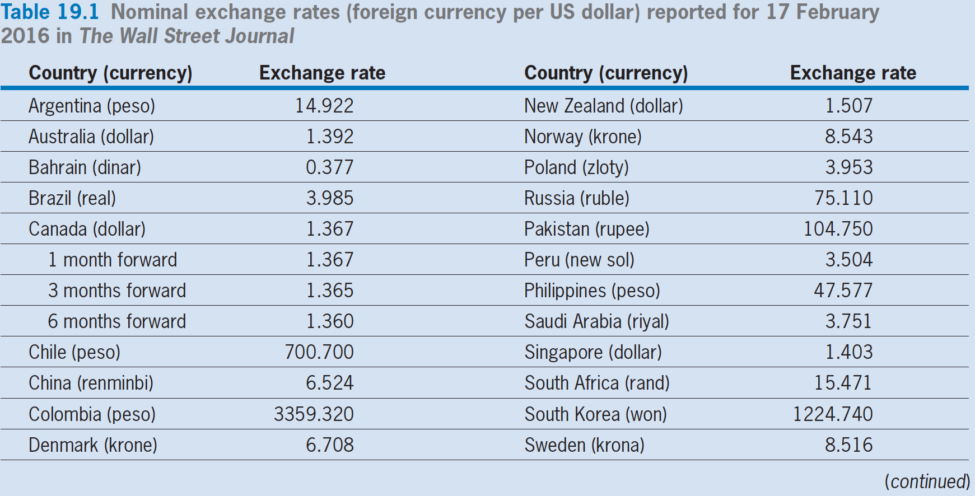
Different Currencies and
Exchange Rates

Slide 18
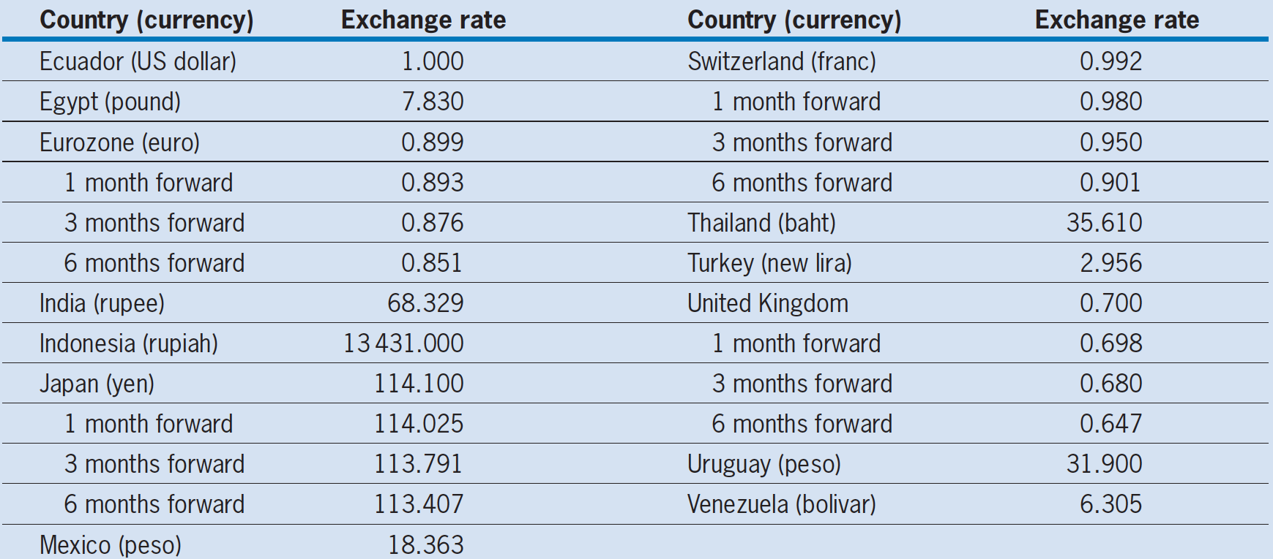
Different Currencies and
Exchange Rates

Slide 19
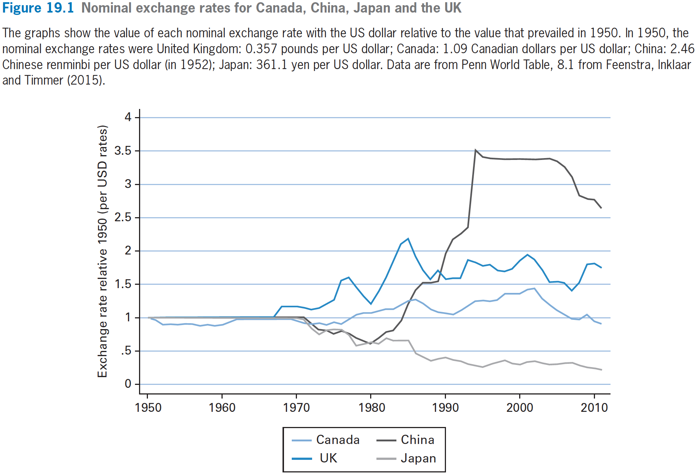
Different Currencies and
Exchange Rates

Slide 20
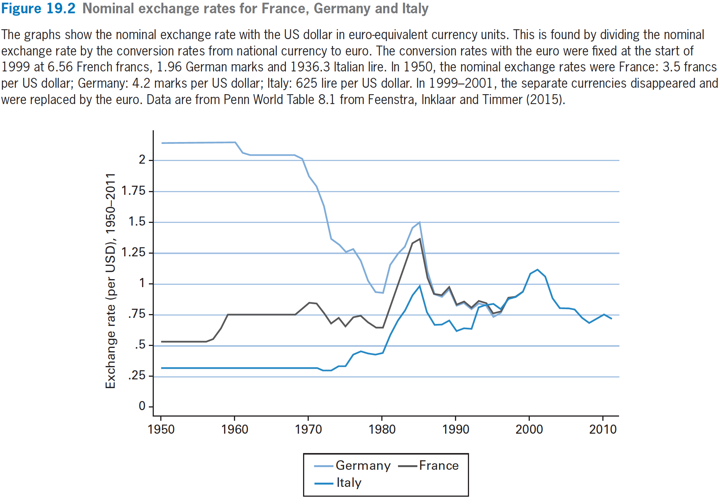
Different Currencies and
Exchange Rates

Slide 21
Purchasing-Power Parity：PPP

Slide 22
Purchasing-Power Parity
The PPP Condition
  The Chinese price level, P, is measured in RMB per unit of goods，比如一个汉堡10元人民币. We denote the UK price level (or foreign price level) by P^{f} , measured in pounds per unit of goods. 比如一个汉堡1元英镑.
  Assume that the goods produced and used in both countries are physically identical. We also ignore any transportation or other transaction costs for buying and selling goods in the two countries.

Slide 23
Purchasing-Power Parity
  Purchasing-Power Parity: ε = P^{f}/P
  nominal exchange rate
  = ratio of foreign price to home price
  This condition means that the purchasing power in terms of goods across currencies is the same, regardless of whether households buy goods in China or in UK.

Slide 24
Purchasing-Power Parity
The Real Exchange Rate
  real exchange rate= ε(P/P^{f})= ε (1/P^{f}) / (1/P)
  real exchange rate is the ratio of goods that can be bought in the UK with ε pound to goods that can be bought in China with 1 RMB.
  Being smaller than 1, means foreign goods is more expensive. On the contrary, bigger than 1 means home goods is more expensive
  Law of one price: real exchange rate=1, The markets work to ensure that the same goods sells at the same price for all buyers and sellers in all locations.

Slide 25
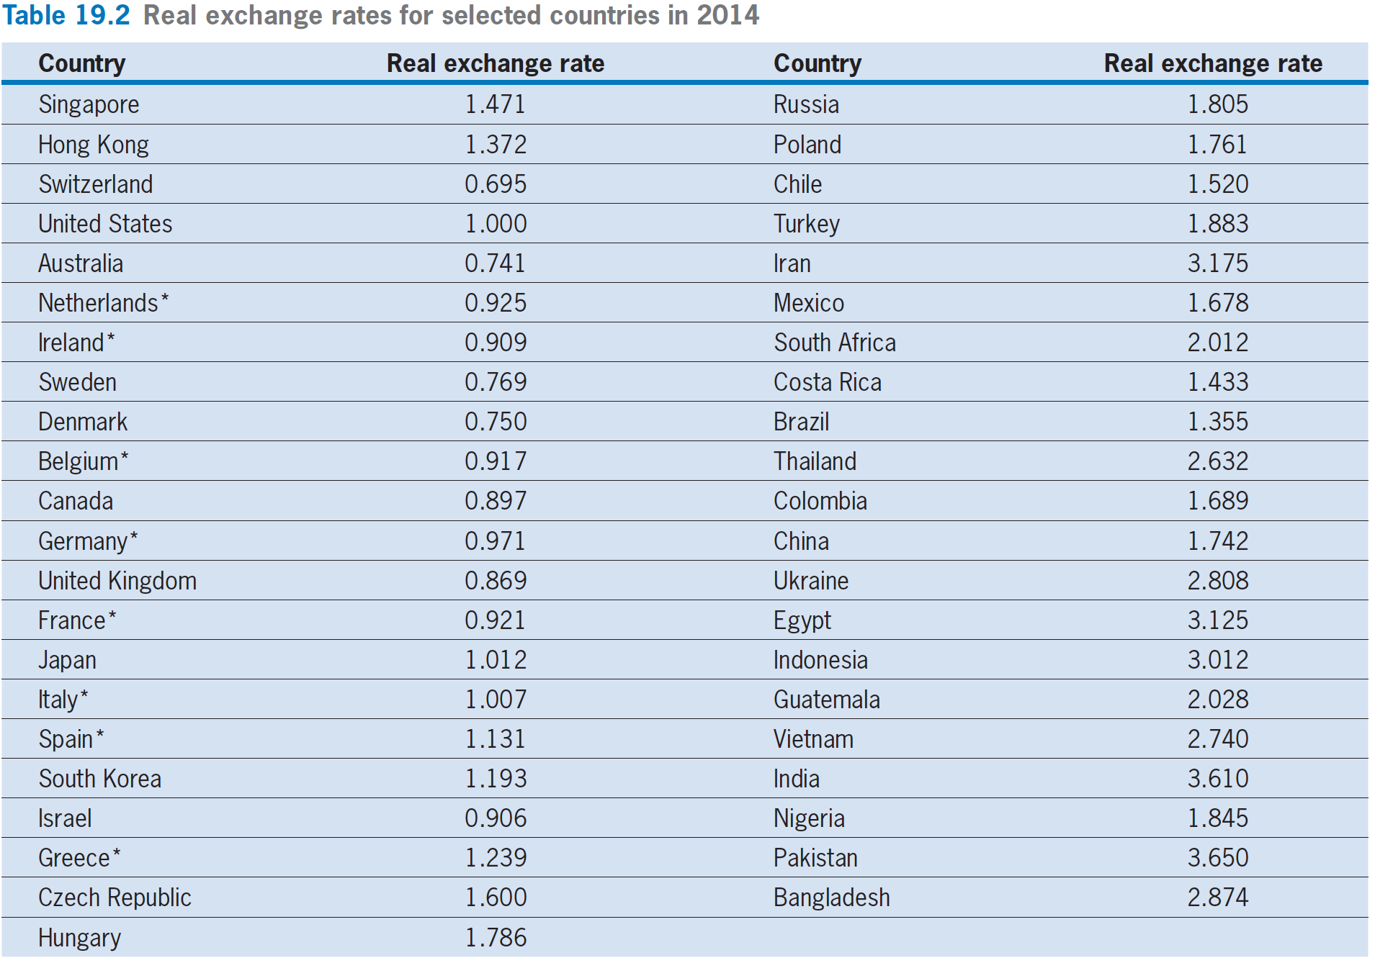

Slide 26
Purchasing-Power Parity
The Relative PPP Condition
  PPP condition：the nominal exchange rate equals the price ratio: ε=P^{f}/P
  real exchange rate: ε(P/P^{f})
  Growth rate of P^{f}/P = ∆P^{f}/P^{f} − ∆P/P
  =π^{f} − π
  Relative PPP:
∆ε/ε = ∆(P^{f}/P) =π^{f} − π
  growth rate of nominal exchange rate
  = foreign inflation rate− home inflation rate
  Growth rate of real exchange rate:
  ∆ε/ε+ ∆P/P - ∆P^{f}/P^{f} = ∆ε/ε+ π- π^{f}
  if relative PPP holds, then above=0
  if smaller than 0, then 本国商品变便宜了。

Slide 27
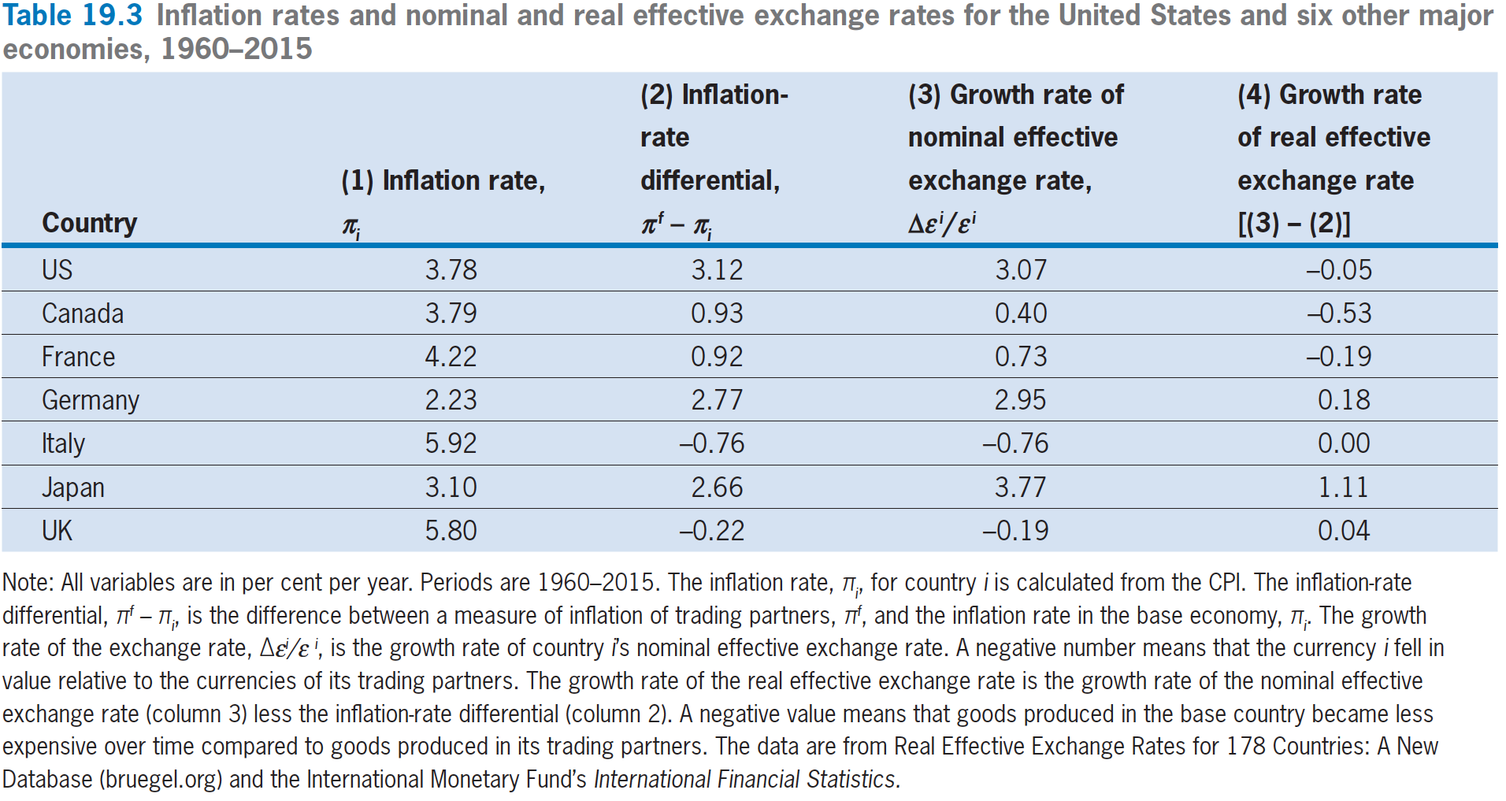
Purchasing-Power Parity

Slide 28
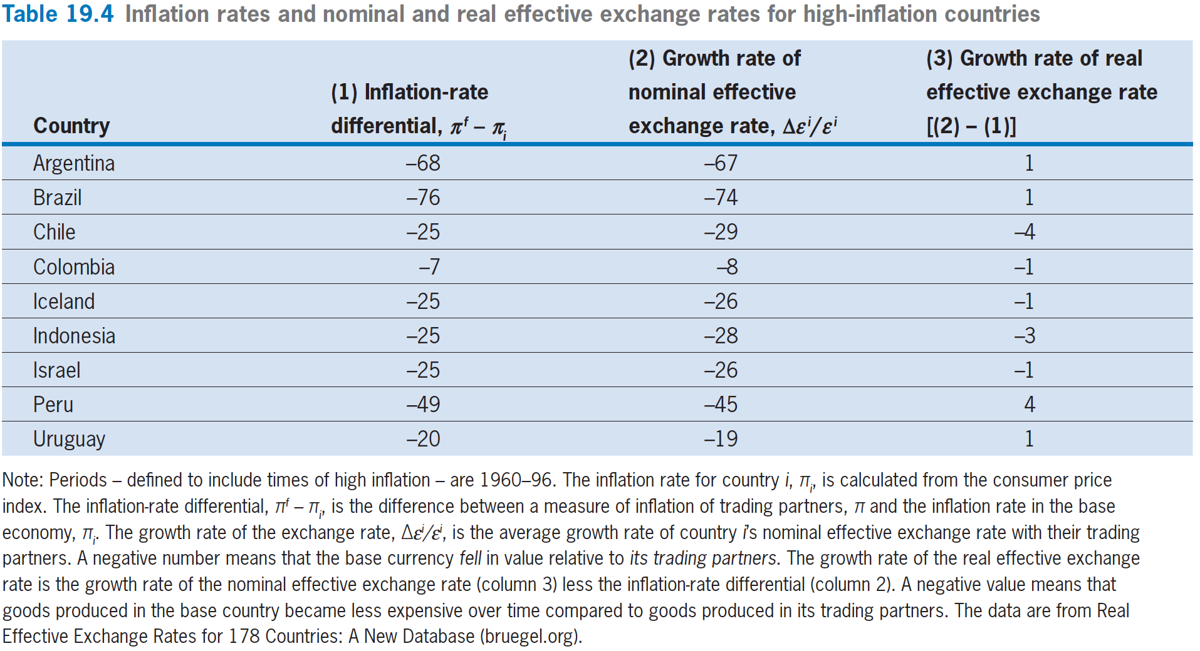
Purchasing-Power Parity

Slide 29
Interest-Rate Parity

Slide 30
Interest-Rate Parity
Option 1: Hold Chinese bond
  RMB received in year _{t+1} = 1+i
Option 2: Use exchange market and hold UK bond
  RMB received in year _{t+1} = ε_{t}·(1+i^{f})/ε_{t+1}
1+i = ε_{t}·(1+i^{f})/ε_{t+1} ,if interest rate parity holds
  return on holding Chinese bond
  = return on using exchange market and holding UK bond

Slide 31
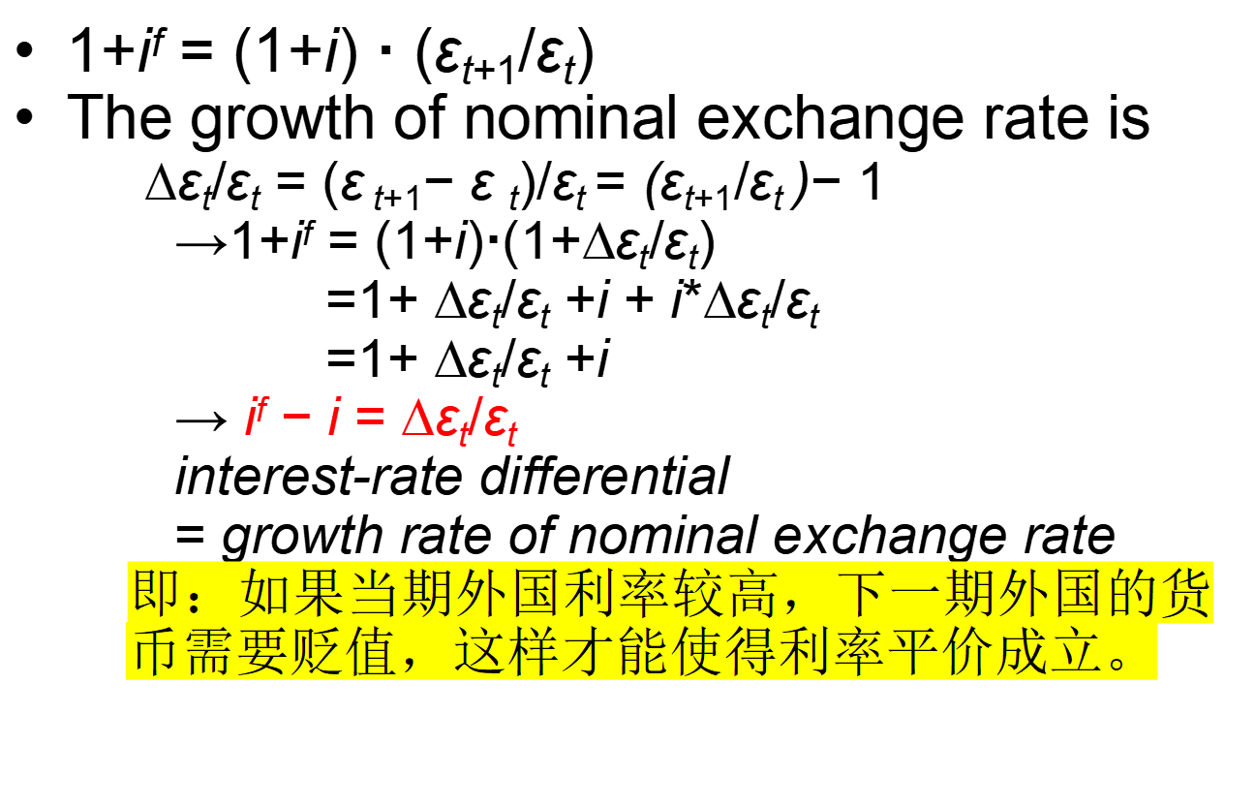
Interest-Rate Parity

Slide 32
Fixed Exchange Rates

Slide 33
Fixed Exchange Rates
Sometimes countries allow their nominal exchange rates to move freely in response to market forces. These systems are called flexible exchange rates.
In other circumstances, countries try to maintain a constant nominal exchange rate with respect to another currency, e.g. the US dollar. These systems are called fixed exchange rates.

Slide 34
Fixed Exchange Rates
The fixed-exchange-rate regime that applied to most advanced countries from World War II until the early 1970s was called the Bretton Woods
Under this system, the participating countries established narrow bands within which they pegged the nominal exchange rate, ε, between their currency and the US dollar.
Each country’s central bank stood ready to buy or sell its currency at the rate of ε units per US dollar.

Slide 35
Fixed Exchange Rates
Purchasing Power Parity： ε = P^{f}/P
  P^{f} =ε P
  ∆ε/ε = ∆(P^{f}/P) =π^{f} − π
  Interest-Rate Parity：
  ∆ε_{t}/ε_{t} = i^{f} − i
Under Fixed Exchange Rates, that is the nominal exchange rate, ε, is fixed, ∆ε_{t}/ε_{t} =0, then
  π^{f} = π
  i^{f} = i

Slide 36
Fixed Exchange Rates
A devaluation, which is a reduction in the value of the pound compared to RMB.
A revaluation:
  An appreciation of the UK currency is called a revaluation: an increase in 1/ε, the number of RMB that exchange for each pound increases.

Slide 37
Flexible Exchange Rates

Slide 38
Flexible Exchange Rates
Since the early 1970s, most advanced countries have allowed their currencies to vary more or less freely to clear the markets for foreign exchange – Flexible Exchange Rates
The difference from the fixed-exchange-rate setup is that the nominal exchange rate, ε, is not a fixed number.
Because of adjustments of ε in a flexible-rate regime, P^{f} need not move in lockstep with P even if the absolute PPP condition always holds.

Slide 39
Fixed and Flexible Exchange Rates: A Comparison
An extreme form of fixed nominal exchange rate is a common currency.
One advantage of a flexible nominal exchange rate is that it introduces an additional way to satisfy the PPP condition, P^{f} = εP
A fixed-exchange rate system precludes an independent monetary policy, at least in the long run.

